Slide 1
Welcome Back! January 8, 2015
8th Grade Science
SWBAT describe different phases of the moon.
Bell Ringer: If the last full moon was January 5th, what phase of the moon can we currently see?
Today – Notes – Moon Cycle (finish up)
Homework – Reading – Earth’s Moon

Slide 2
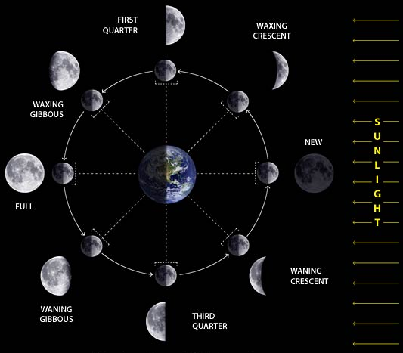
When we put it ALL together!
Why are there
two rings of
moons?

Slide 3
Moon Phases – First two weeks
New Moon
Waxing Crescent (waxing means it will be brighter!)
First Quarter (because calling it a half moon was just too hard!)
Waxing Gibbous (Almost a full moon)

Slide 4
Moon Phases – Last Two Weeks
Full Moon – We had one a few nights ago
Waning Gibbous –(The light is now on the left side)
Third Quarter – (Half moon, light on the left)
Waning Crescent – (Almost back to New Moon)

Slide 5
Moon Phases

