Slide 1
Welcome Back! January 7, 2015
8th Grade Science
SWBAT describe different phases of the moon.
Bell Ringer: What season would you find in South Africa in December? Why?
Today – Notes – Moon Cycle
Homework – Reading – Earth’s Moon

Slide 2
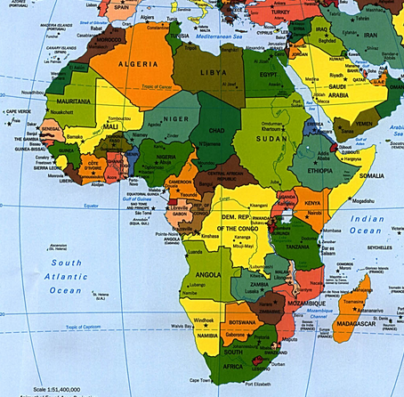

Slide 3
8.7 The student knows the effects resulting from cyclical movements of the Sun, Earth, and Moon.
(B) demonstrate and predict the sequence of events in the lunar cycle.
Demonstrate – describe, explain, or illustrate.
Predict – tell what comes next.
Examples:
What moon phase do you see when the moon is between the Earth and the Sun?
What major moon phase will appear seven days later?

Slide 4
Basic Facts
The moon does not produce its own light. We see the moon because it reflects sunlight back towards Earth. (Not that difficult)
The moon itself does not change but its position relative to the Sun and Earth does change. (What does that mean?)
The lunar cycle is approximately 29.5 days.

Slide 5
More advanced information
There are four major phases of the lunar cycle: new moon, 1st quarter, full moon and 3rd quarter (also called last quarter).
There are four other minor phases of the lunar cycle: waxing crescent, waxing gibbous, waning crescent, and waning gibbous.
The change in the moon’s position relative to the Sun and Earth causes the lunar phases.

Slide 6
Moon Phases – First two weeks
New Moon
Waxing Crescent (waxing means it will be brighter!)
First Quarter (because calling it a half moon was just too hard!)
Waxing Gibbous (Almost a full moon)

Slide 7
Moon Phases – Last Two Weeks
Full Moon – We had one a few nights ago
Waning Gibbous –(The light is now on the left side)
Third Quarter – (Half moon, light on the left)
Waning Crescent – (Almost back to New Moon)

Slide 8
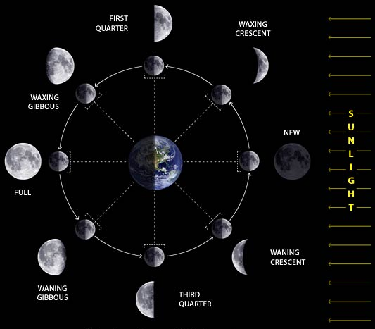
When we put it ALL together!
Why are there
two rings of
moons?

Slide 9
Moon Phases

